Slide 1

SHARING THE ROAD AN INTELLIGENT TRANSPORTATION SYSTEM APPROACH
UNDER THE GUIDANCE OF :
DR. NIRANJAN PANIGRAHI
ASSISTANT PROFESSOR
PRESENTED BY :
MANNMATH SAMANTARAY{tpr}
CSE DEPARTMENT
REGD NO - 1401109180

Slide 2
OUTLINE
WHAT IS AN ITELLIGENT TRANSPORTATION SYSTEM (ITS)
EVOLUTION OF ITS
TECHNOLOGIES USED BY ITS
DEDICATED SHORT RANGED COMMUNICATION (DSRC)
DSRC EQUIPED VEHICLE ARCHITECTURE
USES OF DSRC
EMERGENCY VEHICLE PRE-EMPTION USING SENSORY NETWORK
CONCLUSION
REFERENCES

Slide 3
WHAT IS AN INTELLIGENT TRANSPORTATION SYSTEM
ITS is an emerging transportation system which is comprised of an advanced information and telecommunications network for users, roads and vehicles.
SMART CITY
KNOWLEDGE CITY
GREEN CITY
DIGITAL CITY

Slide 4
EVOLUTION OF ITS
MANET
WANET
AD-HOC NETWORK
VANET
ITS

Slide 5
TECHNOLOGIES USED BY ITS
WIRELESS COMMUNICATION
SHORT - RANGED COMMUNICATION (IEEE 802.11) – Dedicated Short Ranged Communication
LONG – RANGED COMMUNICATION (IEEE 802.16) – Wi-MAX
COMPUTATIONAL TECHNOLOGY
This technology is based on embedding micro-controller in a vehicle to obtain geographical information and use that to improve our transportation methods.
3. FLOATING CAR /CELLULAR DATA
TRIANGULATION METHOD – Uses cell-sector statistics
VEHICLE RE-IDENTIFICATION
GPS BASED METHODS

Slide 6
TECHNOLOGIES USED BY ITS (CONTD.)
4. INDUCTIVE LOOP DETECTION
- Inductive loops can be placed in a roadbed to detect vehicles as they pass through the loop's magnetic field.
- Intrusive method of traffic detection
5. VIDEO VEHICLE DETECTION
- Traffic-flow measurement and automatic incident detection using a video camera
- Non-intrusive method of traffic detection
6. AUDIO VEHICLE DETECTION
- Traffic-flow measurement using an acoustic sensor network

Slide 7
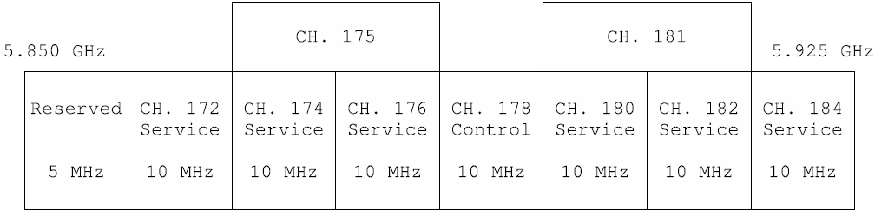
DEDICATED SHORT RANGED COMMUNICATION (DSRC)
A SHORT RANGED COMMUNICATION STANDARD DEPLOYED BY U.S.A.
THE MAIN AIM IS TO CREATE A CONNECTED VEHICLE NETWORK
COMMUNICATIVE AREA RANGED UPTO MAXIMUM 1000 METERS
HIGHLY COMPATIBLE WITH VANET NETWORKING PROTOCOLS
A VERY LOW LANTENCY, MAXIMUM 50 MICRO-SECONDS

Slide 8
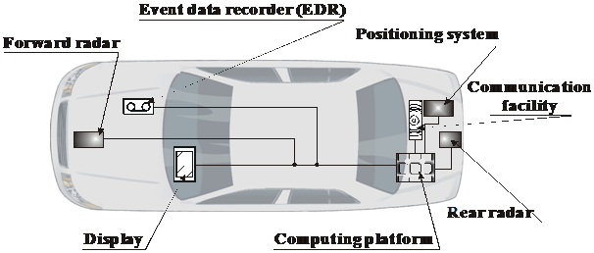
DSRC EQUIPED VEHICLE ARCHITECTURE

Slide 9
USES OF DSRC
PUBLIC SAFETY
TRAFFIC SIGNAL VIOLATION WARNING
EMERGENCY ELECTRONIC BRAKE LIGHT WARNING
NON-PUBLIC SAFETY
CURVE SPEED WARING
EMERGENCY VEHICLE PRE-EMPTION
GAS PAYMENT
PARKING LOT PAYMENT
POINT-OF-INTEREST NOTIFICATION
INSTANT MESSAGING
DATA TRANSFER

Slide 10
EMERGENCY VEHICLE PRE-EMPTION USING SENSORY NETWORK
THE PROBLEM –
1. EMERGENCY VEHICLES (EV) GET STUCK IN THE TRAFFIC MANY TIMES, WHICH MIGHT PUT PEOPLE’S LIVES INTO RISKS.
2. IF WE COULD SENSE AN EV BEFORE ITS ACTUAL ARRIVAL AT THE JUNCTION,THEN ONLY WE COULD MANIPULATE THE TRAFFIC AND CLEAR A PATH FOR THE EV.
3. SO WHAT WE CAN DO IS TO TAKE HELP OF SENSORY NETWORKS. WE CAN DEVELOP THE URBAN TRAFFIC MANAGEMENT SYSTEM AND USE THE ACOUSTIC SENSORS TO DETECT THE VEHICLE.
4. THEN USING THE ROAD-SIDE-UNIT WE CAN WARN A TRAFFIC NODE BEFORE HAND.NOW BY USING THE IMAGE PROCESSING WE CAN CALCULATE THE DISTANCE OF EV, TRAFFIC DENSITY AND USE THIS DATA TO MANIPULATE TRAFFIC LIGHTS.

Slide 11
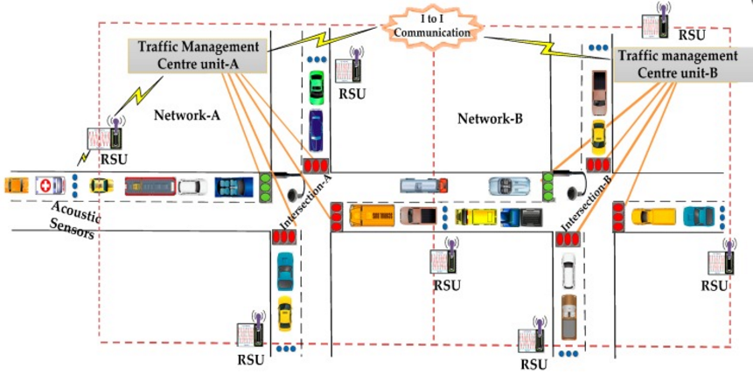
THE ARCHITECTURE OF AN URBAN TRAFFIC MANAGEMENT SYSTEM (UTMS)

Slide 12
METHODS FOLLOWED
1. TRAFFIC MANAGEMENT CENTERS
2. USING DISTANCE MEASUREMENT TECHNIQUES
EUCLIDEAN DISTANCE MEASUREMENT METHOD
MANHATTAN DISTANCE MEASUREMENT METHOD
CANBERRA DISTANCE MEASUREMENT METHOD
3. VEHICLE COUNTING METHOD USING DYNAMIC IMAGE PROCESSING
4. DEPLOYING THE DISTANCE BASED EV DISPATCHING ALGORITHM

Slide 13
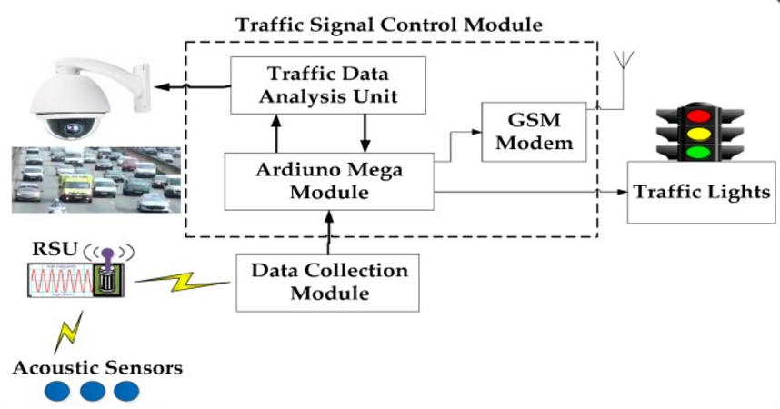
TRAFFIC MANAGEMENT CENTERS

Slide 14
USING DISTANCE MEASUREMENT TECHNIQUES
BASICALLY THERE ARE 3 DISTANCE MEASUREMENT TECHNIQUES USING WHICH WE CAN MEASURE THE DISTANCE OF AN OBJECT FROM A PARTICULAR LOCATION BY USING AN IMAGE.
THE TECHNIQUES DISCUSSED ARE PURELY MATHEMATICAL THAT ARE BASED ON 2D GEOMETRY.
1. EUCLIDEAN DISTANCE METHOD
2. MANHATTAN DISTANCE METHOD
3. CANBERRA DISTANCE METHOD

Slide 15
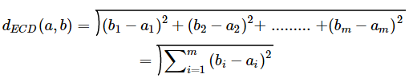

EUCLIDEAN DISTANCE METHOD
If a = (a₁, a₂, a₃,…, a_{m}) and b = (b₁, b₂, b₃,…, b_{m}) are the two points in m-space, then the Euclidean distance (d_{ECD}) between points a and b or b and a is as follows:
Let the pixels within a two-dimensional frame (x, y) be divided into two classes: object pixels and background pixels. For 2D points, a = (a₁, a₂) and b = (b₁, b₂) the Euclidean distance is:

Slide 16


MANHATTAN DISTANCE METHOD
The Manhattan distance between two points is the absolute sum of the differences of their coordinates. In general, if a = (a₁, a₂, a₃,…, a_{m}) and b = (b₁, b₂, b₃,…, b_{m}) are the two points in m-space, then the Manhattan distance (d_{MHD}) between a and b is defined as follows:
The Manhattan distance between points a = (a₁, a₂) and b = (b₁, b₂) is:

Slide 17


CANBERRA DISTANCE METHOD
This distance is a weighted version of the Manhattan distance and is frequently used for data scattered around an origin. In general, if a = (a₁, a₂, a₃,…, a_{m}) and b = (b₁, b₂, b₃,…, b_{m}) are the two points in m-dimensional real vector space, the Canberra distance (d_{CAD}) between a and b is given as follows:
The Canberra distance (d_{CAD}) between two vectors a, b in 2D real vector space is given by:

Slide 18
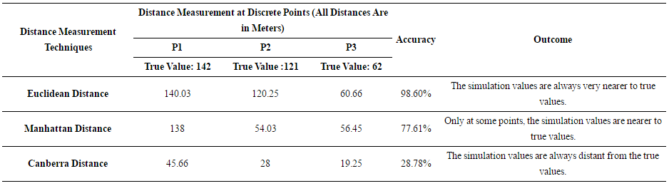
A COMPARISON BETWEEN ALL THE DISTANCE MEASUREMENT METHODS

Slide 19
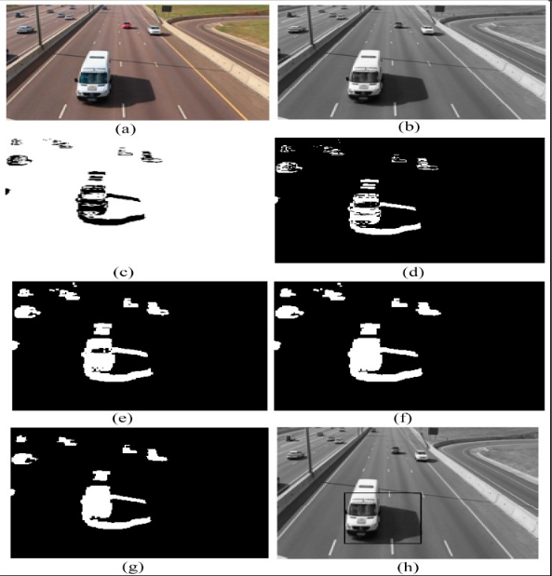
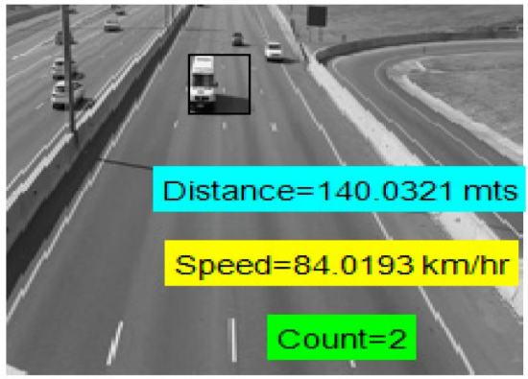
VEHICLE COUNTING USING DYNAMIC IMAGE PROCESING METHOD
AN INPUT IMAGE SEQUENCE OF ROAD TRAFFIC CAN BE PROCESSED AND ANALYZED TO GET VEHICLE COUNTS AND SPEEDS.
(a) RGB FRAME
(b) GRAYSCALE FRAME
(c) DIFFERENCE IMAGE
(d) BINARY IMAGE
(e) DILATED IMAGE
(f) HOLE FILLING IMAGE
(g) ERODED IMAGE
(h) TAGGED VEHICLE

Slide 20
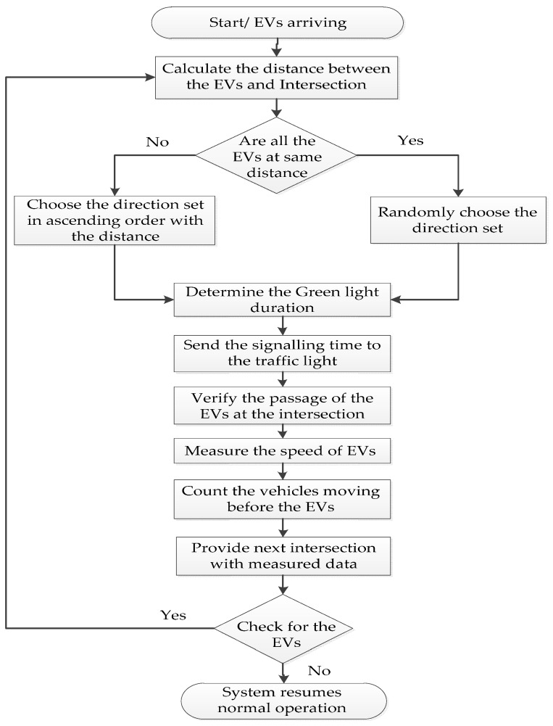
DEPLOYING THE DISTANCE BASED EV DISPATCHING ALGORITHM
THE SENSOR SENSES THE PRESENCE OF EMERGENCY VEHICLES. THE EMERGENCY VEHICLES ARE AMBULANCES, FIRE ENGINES AND POLICE CARS.
CALCULATE THE DISTANCE BETWEEN THE EMERGENCY VEHICLE AND THE INTERSECTION.
THE CONTROLLER CHECKS THAT THE ARRIVING EMERGENCY VEHICLES ARE AT THE SAME DISTANCE OR NOT. IF THEY ARE AT THE SAME DISTANCE, THE CONTROLLER RANDOMLY CHOOSES THE DIRECTION TO SET THE GREEN LIGHT. ELSE, IT CHOOSES THE DIRECTION SET IN ASCENDING ORDER WITH THE DISTANCE.
DETERMINE THE GREEN LIGHT DURATION BASED ON THE MEASURED DISTANCE VALUES AND SEND THESE VALUES TO THE TRAFFIC LIGHTS.
VERIFY THE PASSAGE OF THE EMERGENCY VEHICLE AND MEASURE THE SPEED OF THE EMERGENCY VEHICLE AND COUNT THE VEHICLES MOVING ALONG WITH THE EMERGENCY VEHICLE TOWARDS NEXT INTERSECTION. THE SYSTEM SENDS THE MEASURED DATA TO THE NEXT INTERSECTION.
THE CONTROLLER CHECKS FOR THE PRESENCE OF THE EMERGENCY VEHICLE. IF NO VEHICLE, THEN IT RESUMES NORMAL OPERATION. ELSE, IT CONTINUES TO REPEAT FROM STEP 2 TO STEP 6.

Slide 21
CONCLUSION & FUTUREWORKS
THE EMERGENCY VEHICLE PRE-EMPTION METHOD DISCUSSED EARLIER IS OBVIOUSLY AN EXCELLENT ONE. BUT STILL IT HAS ITS OWN DRAW-BACK.
1. THE MAIN ISSUE IS THE HEAVY ENERGY CONSUMPTION.
ALMOST ALL SENSORS WORK ON A DC CURRENT AND THEY CONSUME A GREAT DEAL OF ELECTRICITY WHILE OPERATING.
AS WE DON’T KNOW AT WHAT PERIOD OF TIME THE EMERGENCY VEHICLE WILL ARRIVE AT THE ROAD-SIDE-UNIT LOCATION,SO WE ARE BOUND TO KEEP THE ACOUSTIC SENORS ONLINE 24*7.
BUT IF HERE WE APPLY THE CONNECTED VEHICLES TECHNOLOGY, WE CAN DETECT THE EV BASED ON THE PRIORITY SIGNAL 300 METERS BEFOREHAND AND THEN TO CONFORM ITS EXISTANCE, WE CAN ACTIVATE THE ACOUSTIC SENSORS AS WELL AS THE VISUAL SENSORS.
SO, IF WE CAN MAKE A USE OF THIS CONNECTED VEHICLE TECHNOLOGY, IT WILL INCREASE THE EFFICIENY OF OUR TRAFFIC LIGHT CONTROLLING PROCESS.

Slide 22
REFERENCES
Jinhua Guo and Nathan Balon . Vehicular Ad Hoc Networks and Dedicated short-Range Communication . ( nbalon.info/projects/cis695/vanet_chapter.pdf )
K.Srinath , V.Prasad - Design and Implementation of DSRC Encoders for efficient Hardware Utilization ( https://www.ijirset.com/upload/2015/july/13_Design.pdf )
B. Priyanka, Madupu Sanjay - DSRC Applications in Intelligent Transportation System using SOLS Technique for fully reused VLSI Architecture ( www.ijmetmr.com/BPriyanka-MadupuSanjay-2.pdf )
U.S. Department of transportation (http://www.its.dot.org)
Kapileswar Nellore and Gerhard P. Hancke - Traffic Management for Emergency Vehicle Priority Based on Visual Sensing ( https://www.ncbi.nlm.nih.gov/pubmed/27834924 )

Slide 23
THANK YOU

